Slide 1


Challenge #2
Refugee Crisis
The Islamic University of Gaza
Mohammed El-Agha, Abdullah Abu Nada, Ahmed Abu Amsha, Anas Alsalool
Masters in Information Technology, Data Science Track

Slide 2
Many Thanks!
Thank you for giving us this a special opportunity to presents our proposed solution.

Slide 3

What is the Challenge?

Slide 4
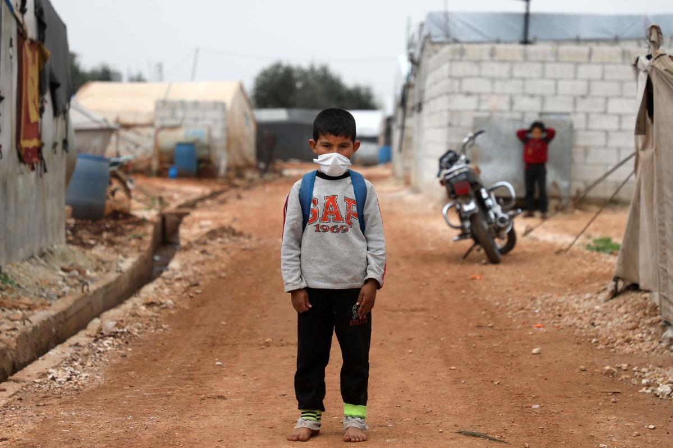
Predicting the number of refugees for next 5 years

Slide 5

01
Datasets Exploration

Slide 6





Used Datasets
Fatalities
Terrain
Distance
Forcibly Displaced
Geomatics

Slide 7
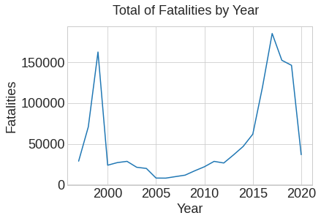
Fatalities
Dataset Analysis
High rates at the end of the 1990s
Followed by a sharp decline
Then, relative stability for 11 years
Then a gradual rise until reaching the highest rates!

Slide 8
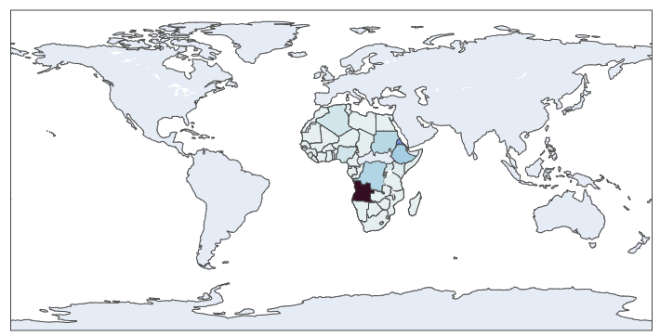
Africa!
1991-2000 Fatalities
Top 5 Countries:
Angola
Eritrea
Ethiopia
Congo
Sudan

Slide 9
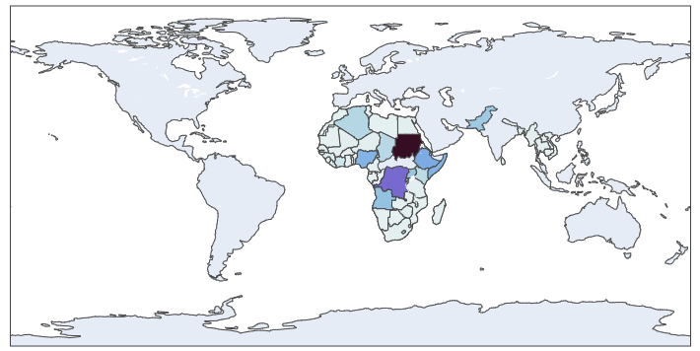
Africa!
2001-2010 Fatalities
Top 5 Countries:
Sudan
Congo
Ethiopia
Somalia
Nigeria

Slide 10
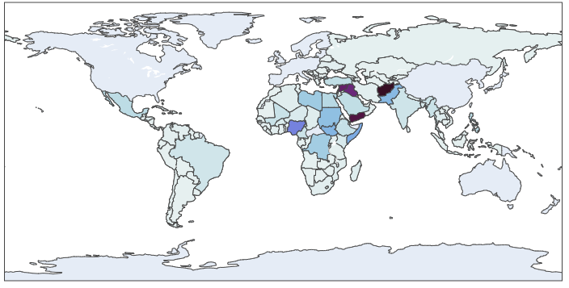
Arab Spring! … Wars!
2001-2010 Fatalities
Top 5 Countries:
Afghanistan
Yemen
Syria
Iraq
Nigeria

Slide 11
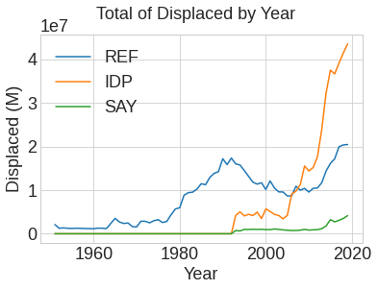
Displaced
High rates of fatalities -> increased rates of refugees

Slide 12


Data Modeling & Results
(Syria as a sample)

Slide 13
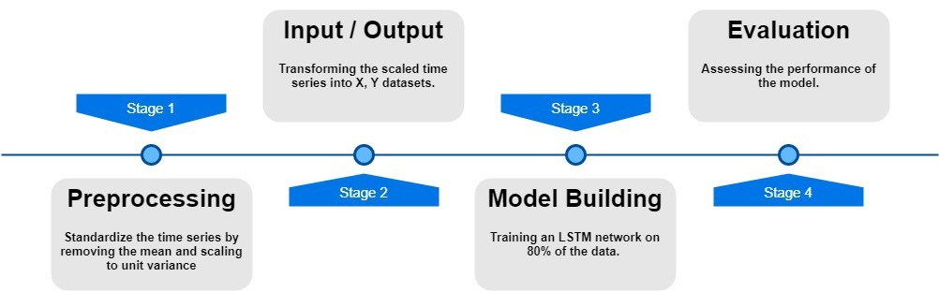

Slide 14
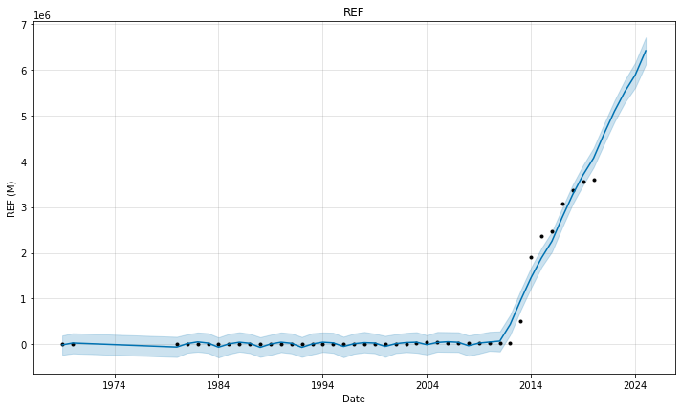
FIT (Displaced Abroad)
(Syria as a sample)

Slide 15
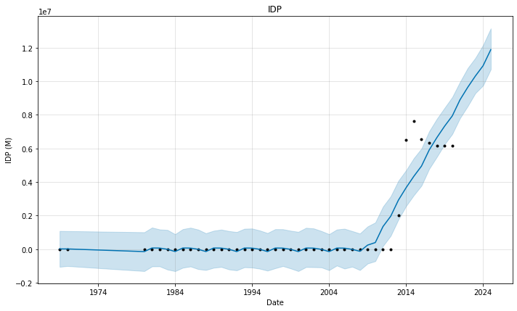
IDP (Displaced Internally)
(Syria as a sample)

Slide 16
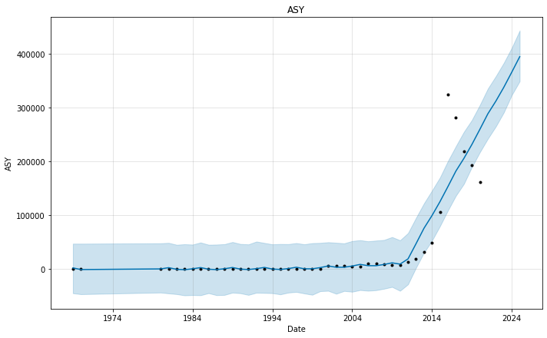
ASY (Asylum Seekers Awaiting Decision)
(Syria as a sample)

Slide 17
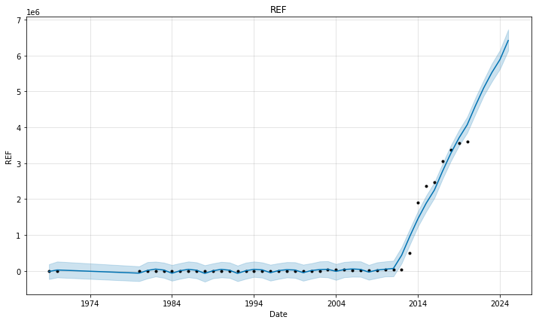
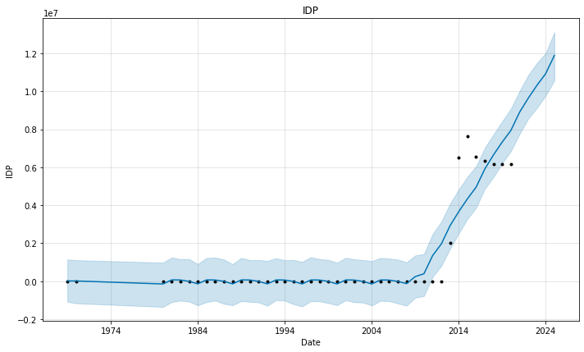
Overall
(Syria as a sample)
A sharp increase in the rates of migration and displacement with the beginning of 2010-2011, the year of the beginning of the Syrian war
The rates of displacement are expected to continue to increase, especially as the war continues

Slide 18

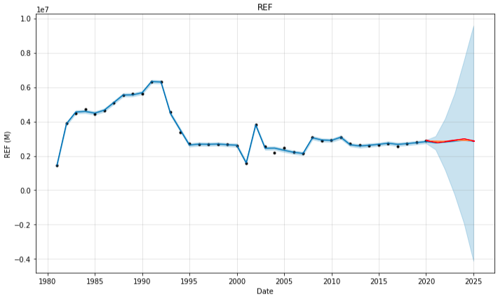
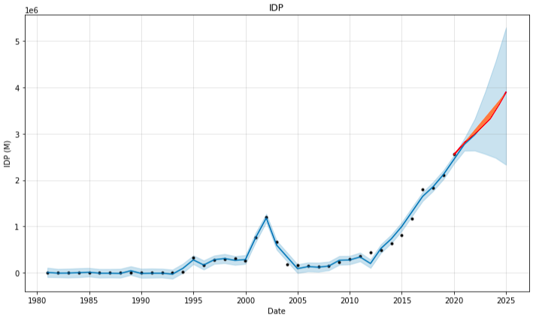
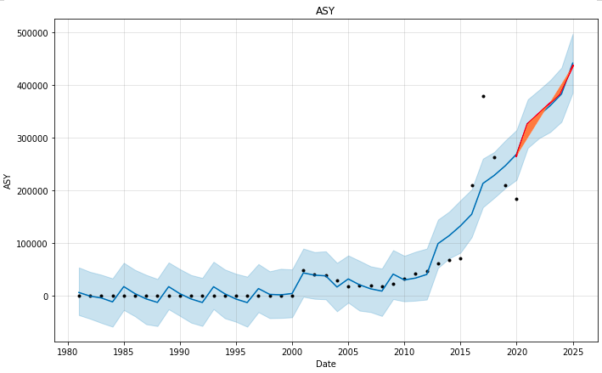

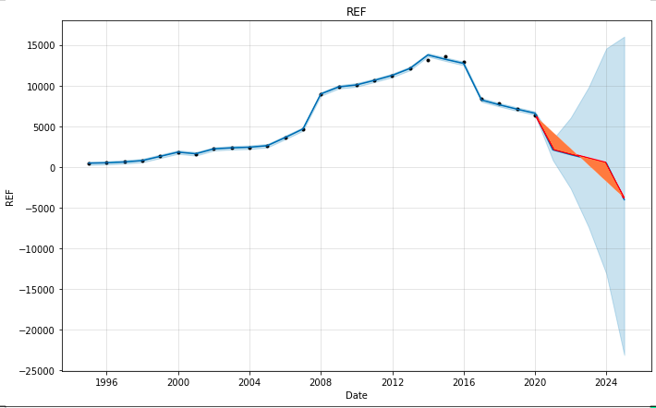
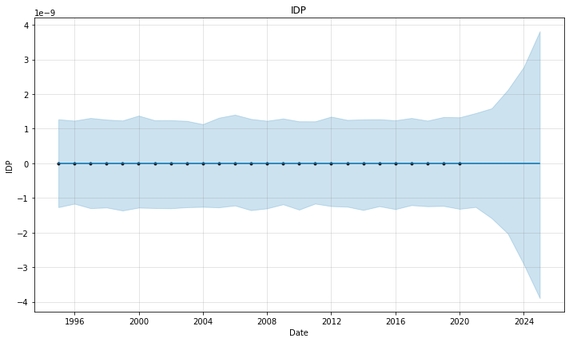
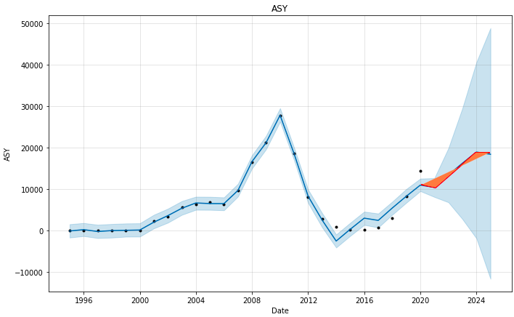
Afghanistan
Mexico

Slide 19

After Finished!

Slide 20
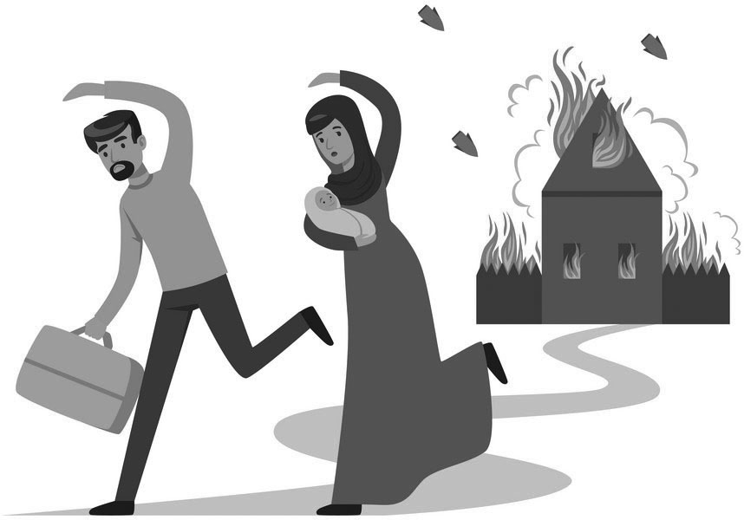
Conclusion
Progression in fatalities global rates
Progression in refugees rates
Last 10 years have the highest rates
Arab spring has a high credit in this increased rates

Slide 21

Lessons learnt by doing this exercise as a team
Big problem becomes small problems!
Teamwork is work
More productivity
More enjoy in work!
The team isn’t working if the team isn’t working

Slide 22

References
Data Hackathon details and datasets
https://github.com/UN-ICC/ICC-Data-Hackathon-2021
Our work
https://github.com/MohammedElagha/FIT-2021-IUG

Slide 23
Many Thanks!

